Slide 1
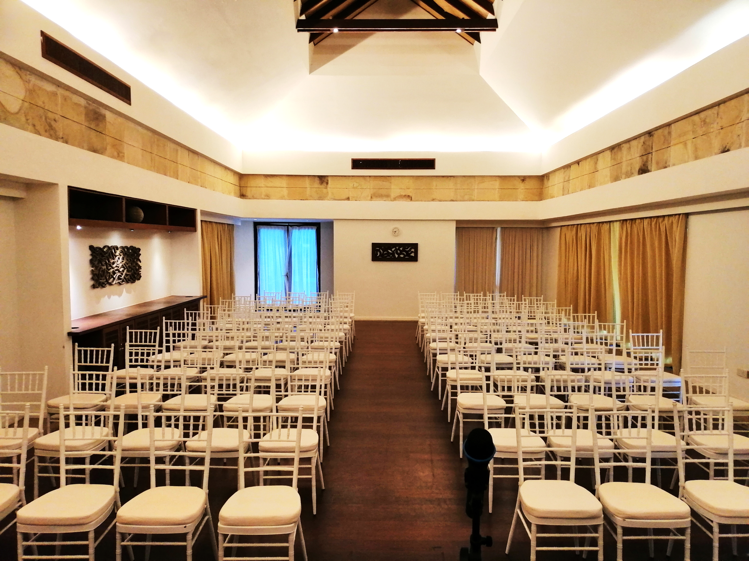
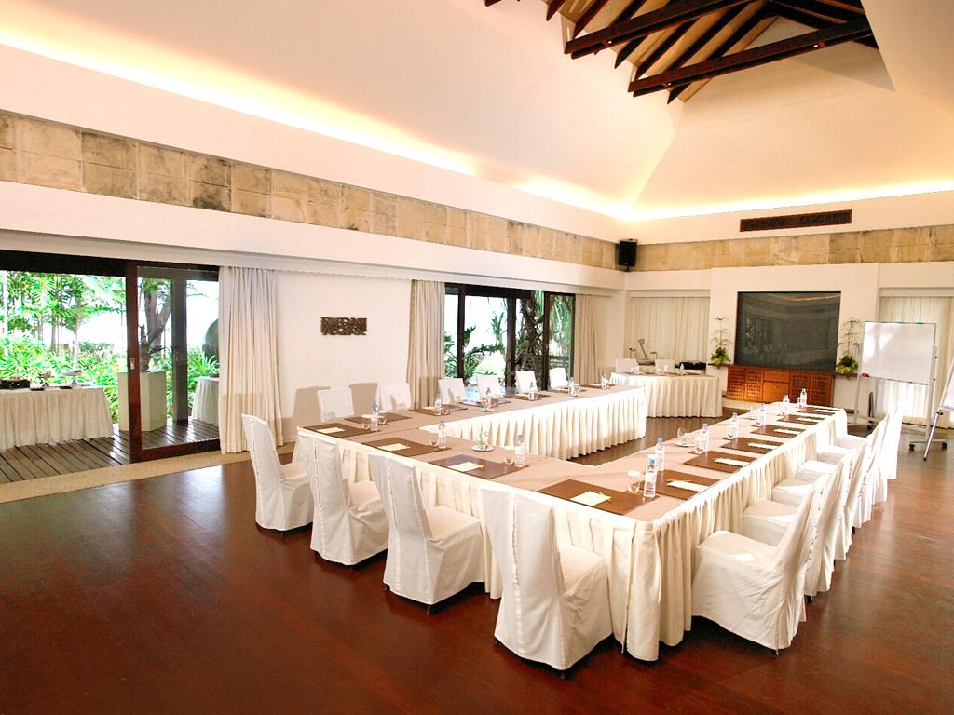
PAVILION MEETING ROOM
Pavilion meeting rooms are ideal for intimate meetings and events. With distinctively furnished meeting rooms, Tanjung Rhu Resorts can tailor the facilities to meet your needs. Organizers can concentrate on their business and guests when fully serviced breaks and high-tech audio-visual equipment are in place. A spacious open foyer adjoins the room, making it ideal for cocktail receptions before events.
MEETING ROOM SIZE : 1200SQM
SEATING LAYOUT | SEATING CAPACITY
U-Shape | 45 Persons
Boardroom | 54 Persons
Classroom | 72 Persons
Theater | 100 Persons
MEETING ROOM FACILITIES
MEETING ROOM AMENITIES
PA sound system
LCD projector
Portable screen
Rostrum
Cordless & Standing Mic
Stationaries
Drinking Water
Light Refreshment

Slide 2
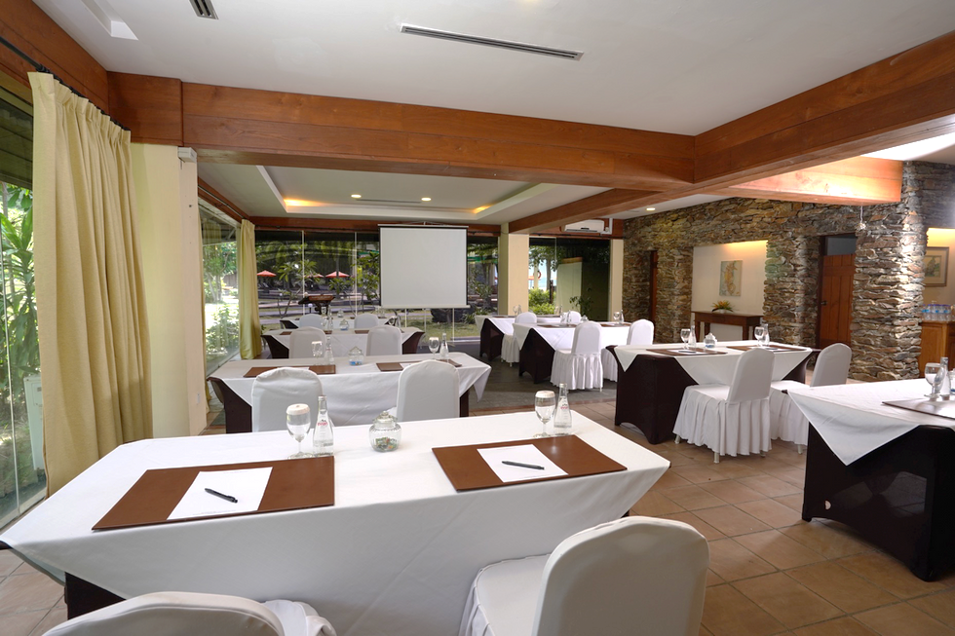
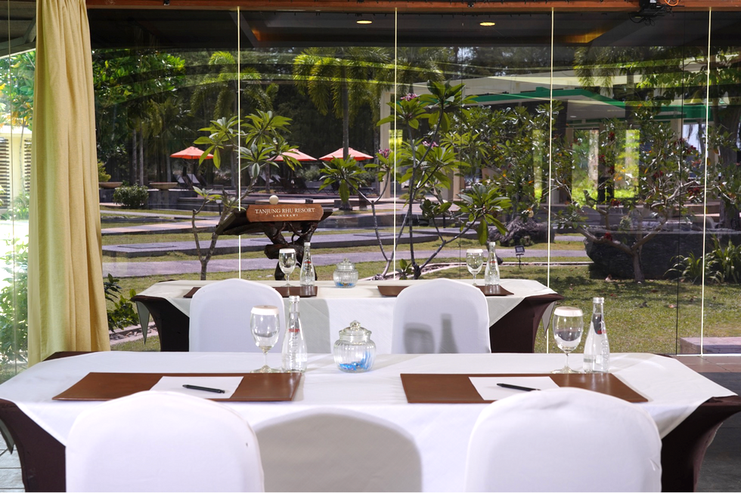
CORAL MEETING ROOM
Creating an inspiring and compact meeting space for your team is possible in the Coral meeting room. You can choose from bespoke packages to support your team building or meeting goals or opt for catered meetings or fine refreshments during breaks to energize you and your team.
MEETING ROOM SIZE : 700SQM
SEATING LAYOUT | SEATING CAPACITY
U-Shape | 14 Persons
Boardroom | 18 Persons
Classroom | 30 Persons
Cluster | 36 Persons
Theater | 80 Persons
MEETING ROOM FACILITIES
MEETING ROOM AMENITIES
PA sound system
LCD projector
Portable screen
Rostrum
Cordless & Standing Mic
Stationaries
Drinking Water
Light Refreshment

